Slide 1
Using Apache Kafka to Build Pipelines for Streaming Data
C8-Week-4
Apache Kafka is a very popular open source event streaming pipeline. An event is a type of data that describes the entity’s observable state updates over time. Popular Kafka service providers include Confluent Cloud, IBM Event Stream, and Amazon MSK. Additionally, Kafka Streams API is a client library supporting you with data processing in event streaming pipelines. In this module, you will learn that the core components of Kafka are brokers, topics, partitions, replications, producers, and consumers. You will explore two special types of processors in the Kafka Stream API stream-processing topology: The source processor and the sink processor. You will also learn about building event streaming pipelines using Kafka.
Learning Objectives
Define what an event is.
List the main components of an ESP.
Explain how Apache Kafka functions as an Event Streaming Platform (ESP).
List popular Kafka-based ESP-as-a-Service providers.
Discuss the core components of Kafka.
Describe an end-to-end event streaming pipeline example.
Explain what the Kafka Streams API is and list its main benefits.
Describe the Kafka Stream processing topology.
Perform basic Kafka tasks for working with streaming data.
Use the kafka-python client to execute common operations with a Kafka server.

Slide 2
Distributed Event Streaming Platform Components
Describe what an Event is.
List the common Event formats.
Describe what an Event Stream Platform (ESP) is.
List the main components of an ESP.
list the popular ESPs

Slide 3
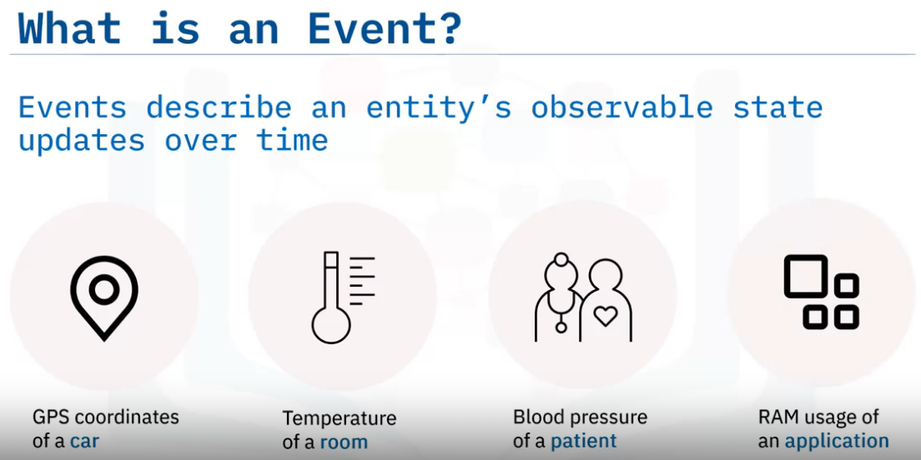
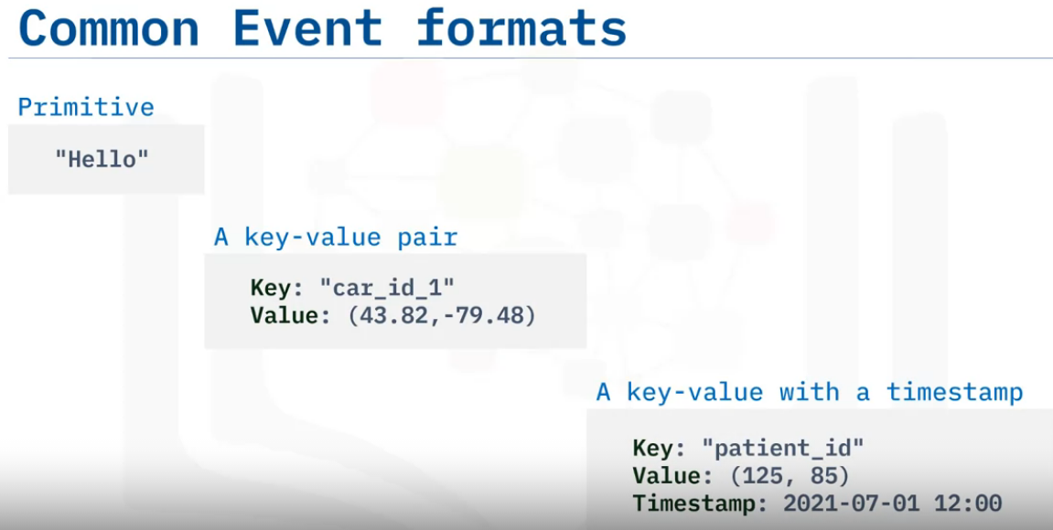
Event : In the context of event streaming, an event is a type of data which describes the entity’s observable state updates over time.
An Event, as a special type for data, has different formats.
Let’s have a look at the three most common formats:
It can be as a primitive type such as a plain text, number, or date,
an event may be in key-value format, and its value can be a primitive data type,
complex data type like list, tuple, JSON, XML, or even bytes. For example, the coordinates tuple of a car with car_id_1.
Also, very often, an event can be associated with a timestamp to make it time-sensitive.

Slide 4
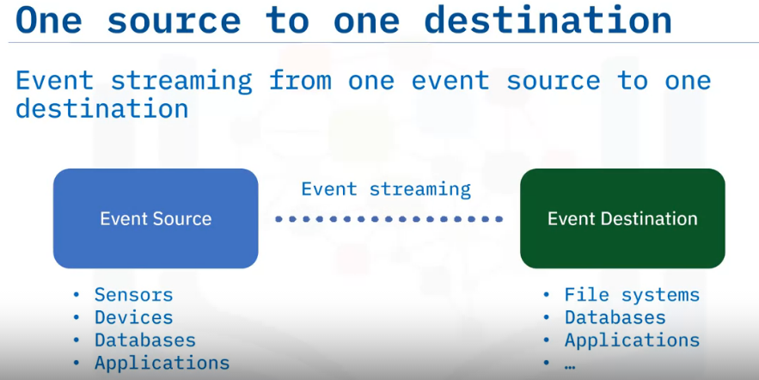
Suppose we have one event source such as a group of sensors, a monitoring device, a database, or a running application.
This event source may continuously generate a large event volume at a short time interval or nearly real-time.
Those real-time events need to be properly transported to an event destination such as a file system, another external database, or an application.
The continuous event transportation between an event source and an event destination is called event streaming.
After all you have learned about ETL so far, you may think that to implement such an ETL process between one event source to one event destination should be straightforward.

Slide 5
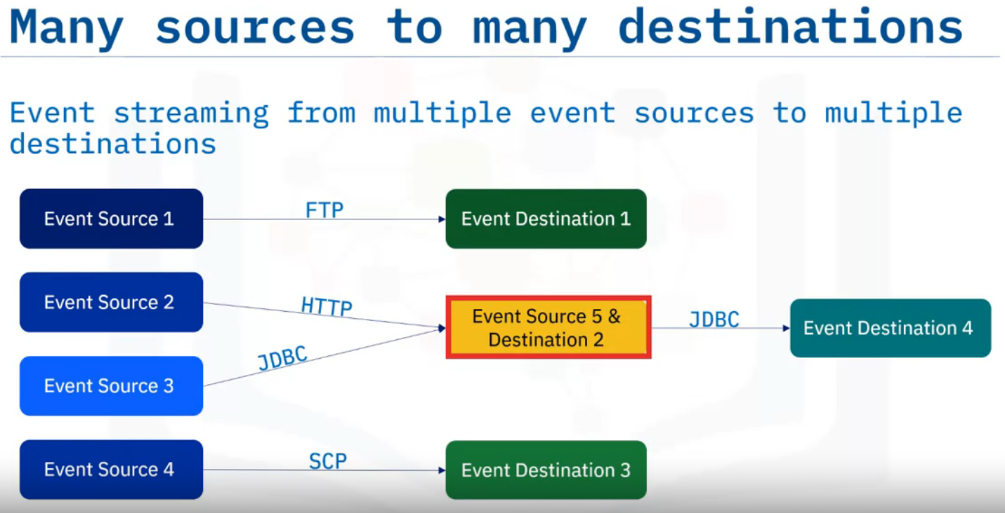
you may think that to implement such an ETL process between one event source to one event destination should be straightforward.
However, what if we have multiple different event sources and destinations?
In a real-world scenario, event streaming can be really complicated with multiple distributed event sources and destinations, as data transfer pipelines may be based on different communication protocols such as:
FTP: File Transfer Protocol
HTTP: Hypertext Transfer Protocol
JDBC: Java Database Connectivity
SCP: Secure copy. And so on.
An event destination can also be an event source simultaneously. For example, one application could receive an event stream and process it, then transport the processed results as an event stream to another destination.
To overcome such a challenge of handling different event sources and destinations, we will need to employ the Event Stream Platform, or ESP.

Slide 6
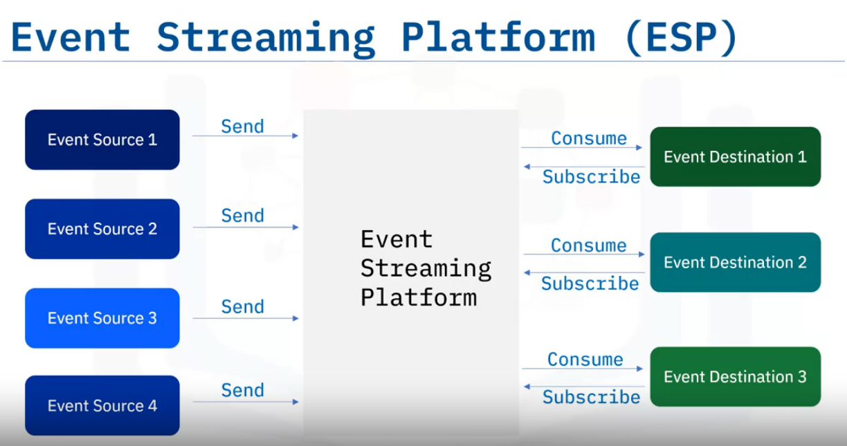
An ESP acts as a middle layer among various event sources and destinations and provides a unified interface for handling event-based ETL.
As such, all event sources only need to send events to an ESP instead of sending them to the individual event destination.
On the other side, event destinations only need to subscribe to an ESP, and just consume the events sent from the ESP instead of the individual event source.

Slide 7
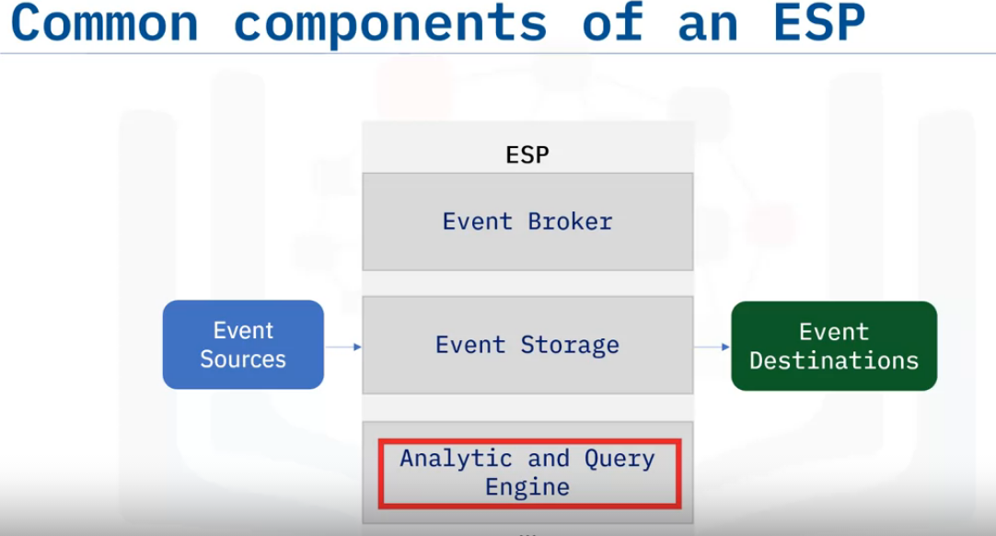
Event Streaming Platform
Different ESPs may have different architectures and components.
Here we show you some common components included in most ESP systems.
The first and foremost core component is the Event broker, which is designed to receive and consume events.
The second common component of an ESP is Event Storage, which is used for storing events being received from event sources.
Accordingly, event destinations do not need to synchronize with event sources, and stored events can be retrieved at will.
The third common component is the Analytic and Query Engine which is used for querying and analyzing the stored events.

Slide 8
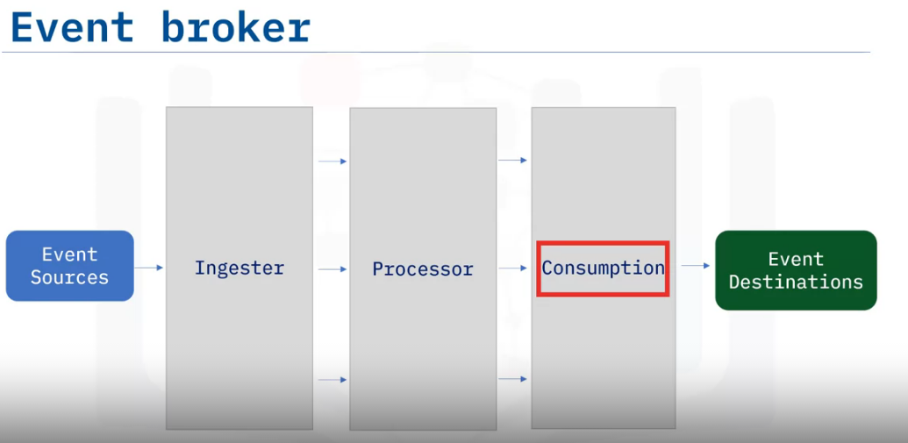
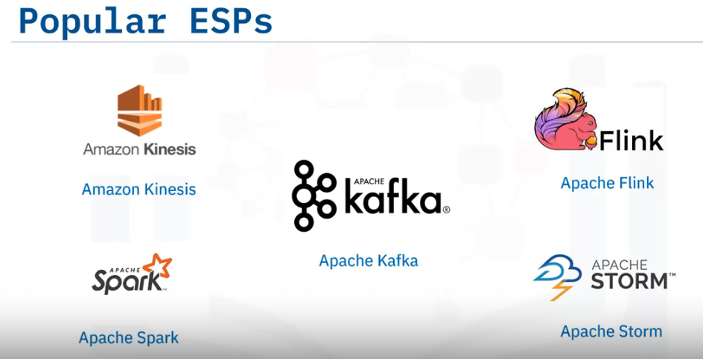
Let’s have a look at the Event broker, which is the core component of an ESP.
It normally contains three sub-components: ingester, processor, and consumption.
The ingester is designed to efficiently receive events from various event sources.
The processor performs operations on data such as serializing and deserializing; compressing and decompressing; encryption and decryption; and so on.
The consumption component retrieves events from event storage and efficiently distributes them to subscribed event destinations.
There are many ESP solutions, including: Apache Kafka Amazon Kinesis Apache Flink Apache Spark Apache Storm and more such as Logstash in Elastic Stack, and so on.
Each has its unique features and application scenarios. Among these ESPs, Apache Kafka is probably THE most popular one.

Slide 9
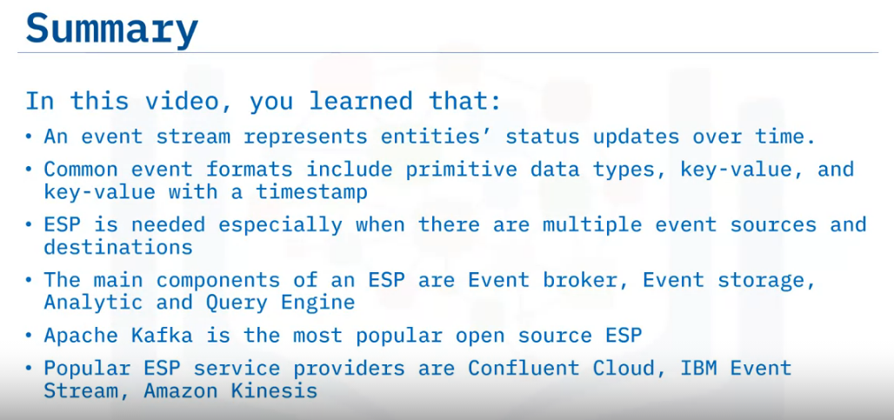

Slide 10
Apache Kafka Overview
Recognize Apache Kafka as an Event Streaming Platform (ESP).
Describe the architecture of Apache Kafka.
List common use cases for Apache Kafka.
Summarize the main features and benefits of Apache Kafka, and list popular Kafka-based ESP-as-a-Service providers.

Slide 11
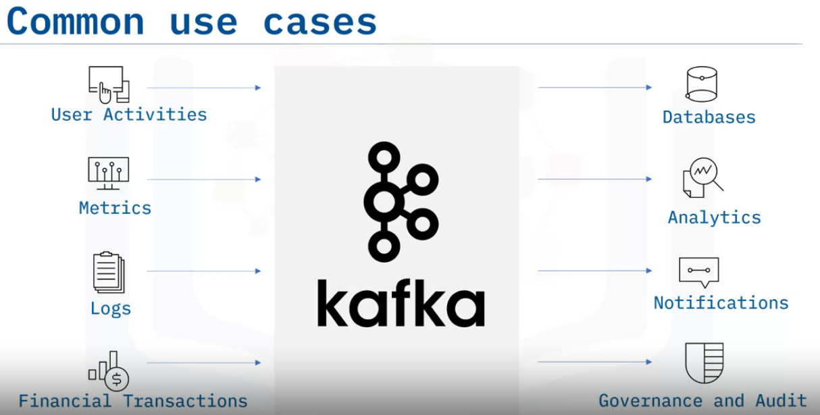
Kafka can be used in many application scenarios. Let's look at some common ones here:
Kafka was originally used to track user activities such as keyboard strokes, mouse clicks, page views, searches, gestures, screen time, etc.
But now it is also suitable for all kinds of metric-streaming such as sensor readings, GPS, as well as hardware and software monitoring.
For enterprise applications and infrastructure with a huge number of logs, Kafka can be used to collect and integrate them into a centralized repository.
For banks, insurance, or FinTech companies, Kafka is also widely used for payments and transactions.
You basically can use Kafka in scenarios when you want high throughput and reliable data transportation services among various event sources and destinations.
All these events will be ingested in Kafka, and become available for subscriptions and consumption including:
Further data storage and movement to other online or offline databases and backups.
Real-time processing and analytics, including dashboard, machine learning, AI algorithms, and so on.
Generating notifications such as email, text messages, and instant messages,
data governance and auditing to make sure sensitive data such as bank transactions are complying with regulations.

Slide 12
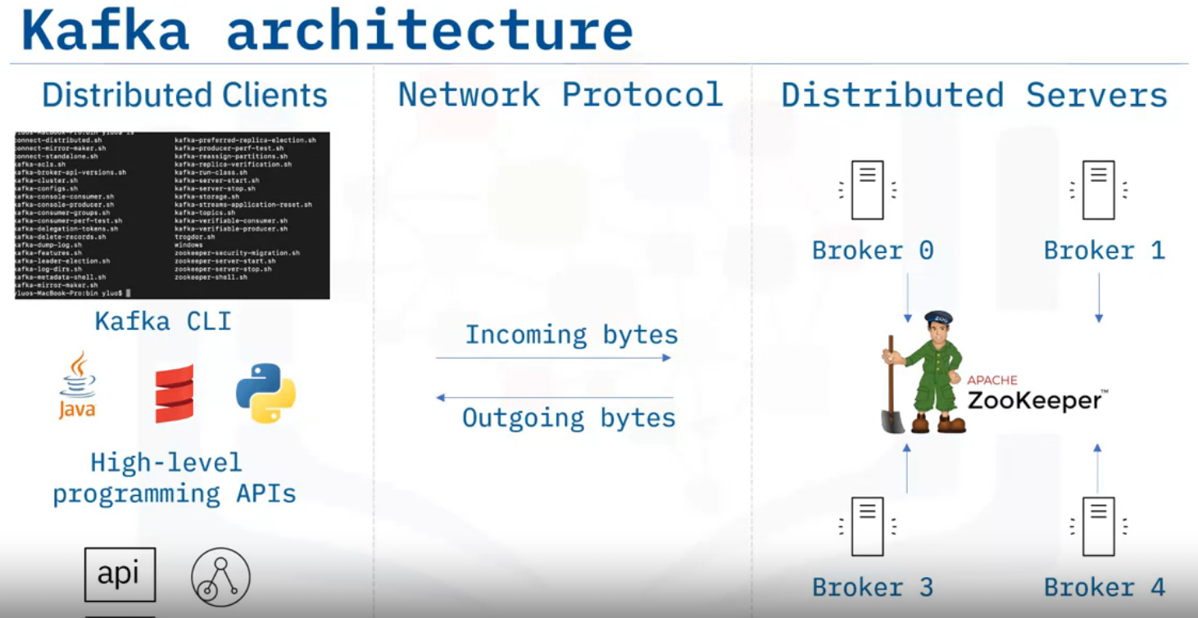
Kafka has a distributed client-server architecture:
For the server side, Kafka is a cluster with many associated servers called brokers, acting as the event broker to receive, store, and distribute events.
All those brokers are managed by another distributed system called ZooKeeper to ensure all brokers work in an efficient and collaborative way.
Kafka uses a TCP (Transmission Control Protocol) based network communication protocol to exchange data between clients and servers.
For the client side, Kafka provides different types of clients, such as Kafka CLI (Command Line Interface) which is a collection of shell scripts to communicate with the Kafka server, many high-level programming APIs such as Java, Scala, REST APIs, and some specific third party clients made by the Kafka community.
Accordingly, you could choose different clients based on your requirements.

Slide 13
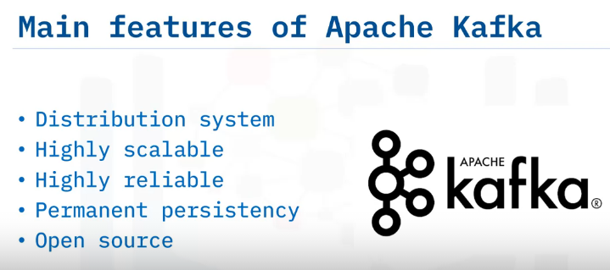
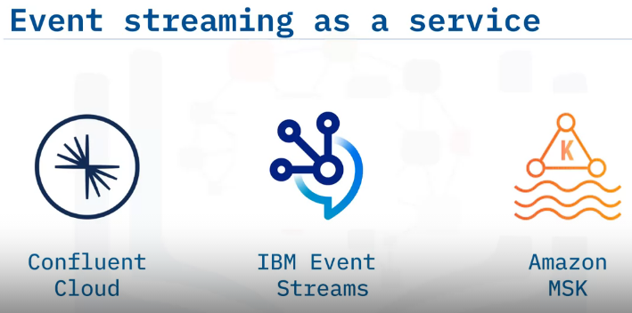
Kafka has the following main features:
It is a distribution system which makes it highly scalable to handle high data throughput and concurrency.
A Kafka cluster normally has multiple event brokers which can handle event streaming in parallel. As such, Kafka is very fast and highly scalable.
Kafka also divides event storage into multiple partitions and replications which makes it fault-tolerant and highly reliable.
Kafka stores the events permanently. As such, event consumption could be done whenever suitable for consumers without a deadline.
And, Kafka is open source, meaning that you can use it for free, and even customize it based on your specific requirements.
Even though Kafka is open source and well-documented, it is still challenging to configure and deploy a Kafka without professional assistance.
Deploying a Kafka cluster requires extensive efforts for tuning infrastructure and consistently adjusting the configurations, especially for enterprise-level deployments.
several commercial service providers offer an on-demand ESP-as-a-Service
Many of them are built on top of Kafka and provide added value for customers.
Confluent Cloud: fully managed Kafka services, either on-premises or on-cloud.
IBM Event Streams, which is also based on Kafka and provides many add-on services such as enterprise-grade security, disaster recovery, and 24-7 cluster monitoring.
Amazon Managed Streaming for Apache Kafka (AWS MAK), : fully managed service to facilitate the build and deployment of Kafka.

Slide 14
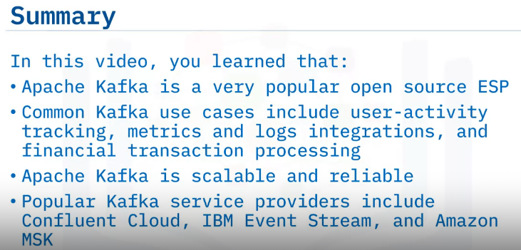

Slide 15
Building Streaming Pipelines with Kafka
Describe the core components of Kafka.
Use Kafka to publish (write) and subscribe to (read) streams of events.
Use Kafka to consume events, either as they occur or retrospectively, and
Describe an end-to-end event streaming pipeline example.

Slide 16
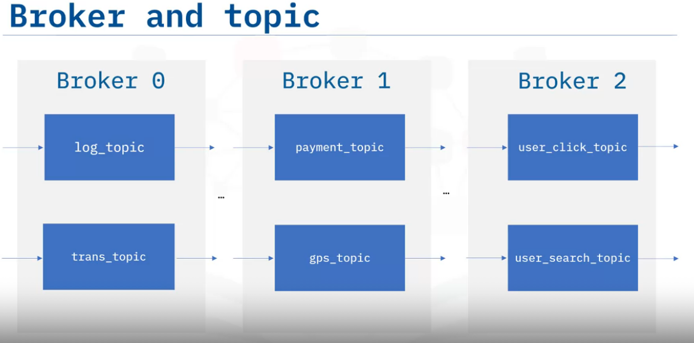
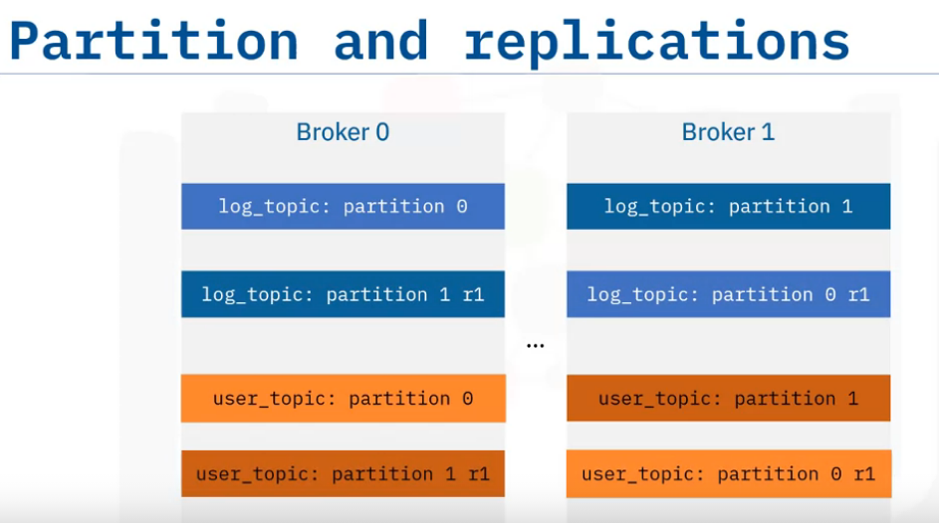
A Kafka cluster contains one or many brokers. You may think of a Kafka broker as a dedicated server to receive, store, process, and distribute events.
Brokers are synchronized and managed by another dedicated server called ZooKeeper.
For example, here we have A log topic and a transaction topic in broker 0. A payment topic and a GPS topic in broker 1. and, a user click topic and user search topic in broker 2.
Each broker contains one or many topics. You can think of a topic as a database to store specific types of events, such as logs, transactions, and metrics, for example. Brokers manage to save published events into topics and distribute the events to subscribed consumers.
Kafka cluster > broker (mngd by ZooKeeper) > topic (Contains Events) > Prtitions > Distributed to Subscribed Consumers
Kafka implements the concepts of partitioning and replicating.
and consumption can be done in parallel with multiple brokers.
In addition, even if some brokers are down, Kafka clients are still able to work with the target topics replicated in other working brokers.
For example:
A log topic has been separated into two partitions: 0, 1, and
a user topic has been separated into two partitions: 0, 1.
And each topic partition is duplicated into two replications and stored in different brokers.

Slide 17
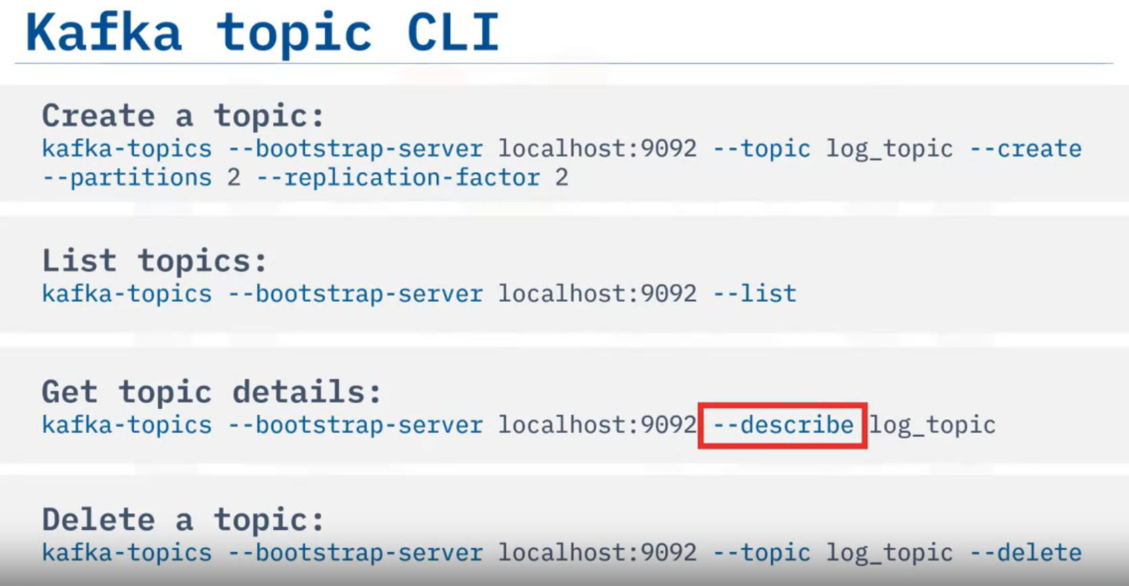
The Kafka CLI, or command line interface client provides a collection of powerful script files for users to build an event streaming pipeline:
The Kafka-topics script is the one you probably will be using often to manage topics in a Kafka cluster. It is straightforward.
Let’s have a look at some common usages:
This first one is to create a topic. Here we are trying to create a topic called ‘log_topic’ with two partitions and two replications.
One important note here is that many Kafka commands, like kaf-topics, require users to refer to a running Kafka cluster with a host and a port, such as a localhost with the port 9092.
After you have created some topics, you can check all created topics in the cluster using the ‘list option.’
And, if you want to check more details of a topic, such as partitions and replications, you can use the ‘describe option’.
And you can delete a topic using the ‘delete option.’

Slide 18
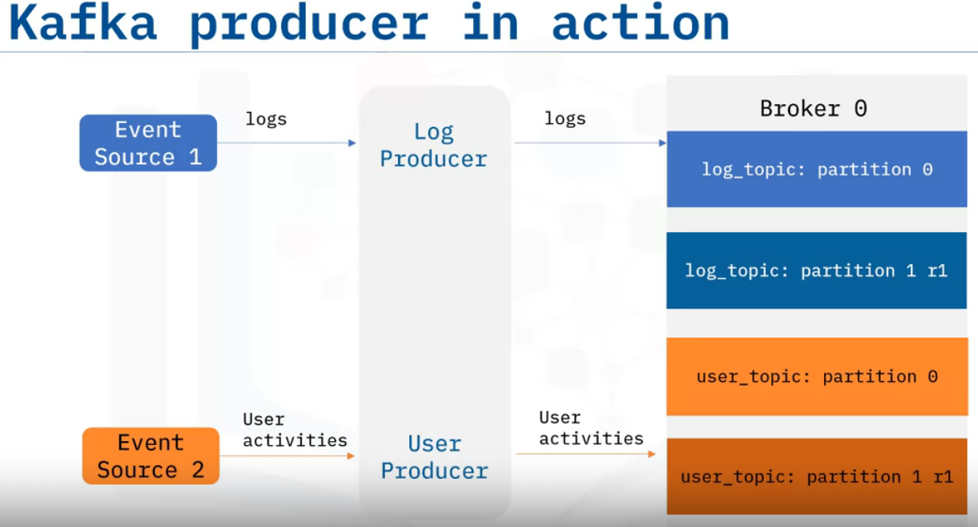
Publishing Events using Kafka Producers.
Features of Kafka producer:
They are client applications that publish events to topic partitions according to the same order as they are published.
When publishing an event in Kafka producer, an event can be optionally associated with a key.
Events associated with the same key will be published to the same topic partition.
Events not associated with any key will be published to topic partitions in rotation.
how you can publish events to topic partitions using the following example:
Suppose you have an event source 1, which generates various log entries, and an event source 2, which generates user-activity tracking records.
Then, you can create a Kafka producer to publish log records to log topic partitions, and a user producer to publish user-activity events to user topic partitions, respectively.
When you publish events in producers, you can choose to associate events with a key, for example, an application name or a user ID.

Slide 19
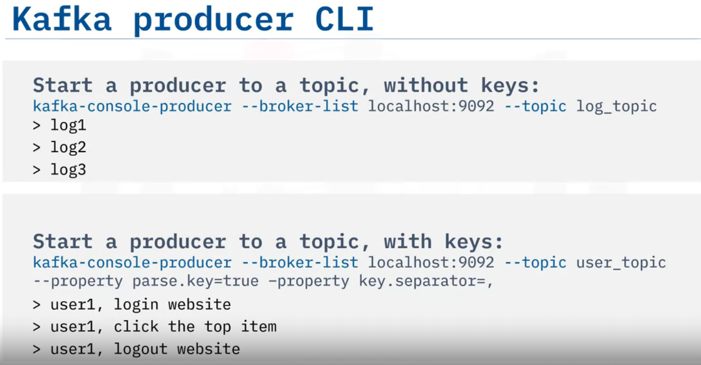
Similar to the Kafka topic CLI, Kafka provides the Kafka producer CLI for users to manage producers.
The most important aspect is starting a producer to write or publish events to a topic:
Here you start a producer and point it to the log_topic, then you can type some messages in the console to start publishing events. For example, log1, log2, and log3.
You can provide keys to events to make sure the events with the same key will go to the same partition.
Here you are starting a producer to user_topic, with the parse.key option to be true, and you also specify the key.separator to be comma.
Then you can write messages as follows: key: ‘user1’, value: ‘login website’.
Key: ‘user1’, value: ‘click the top item’. And, key: ‘user1’, value: ‘logout website’.
Accordingly, all events about user1 will be saved in the same partition to facilitate the reading for consumers.

Slide 20
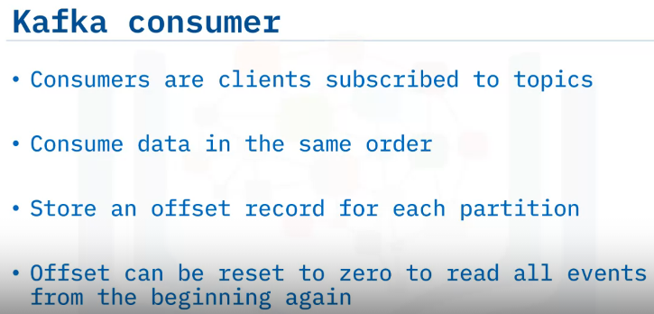
Once events are published and properly stored in topic partitions, you can create consumers to read them.
Consumers are client applications that can subscribe to topics and read the stored events.
Then event destinations can further read events from Kafka consumers.
Consumers read data from topic partitions in the same order as they are published.
Consumers also store an offset for each topic partition as the last read position.
With the offset, consumers are guaranteed to read events as they occur.
A playback is also possible by resetting the offset to zero.
This way the consumer can read all events in the topic partition from the beginning.
In Kafka, producers and consumers are fully decoupled.
As such, producers don’t need to synchronize with consumers, and after events are stored in topics, consumers can have independent schedules to consume them.

Slide 21
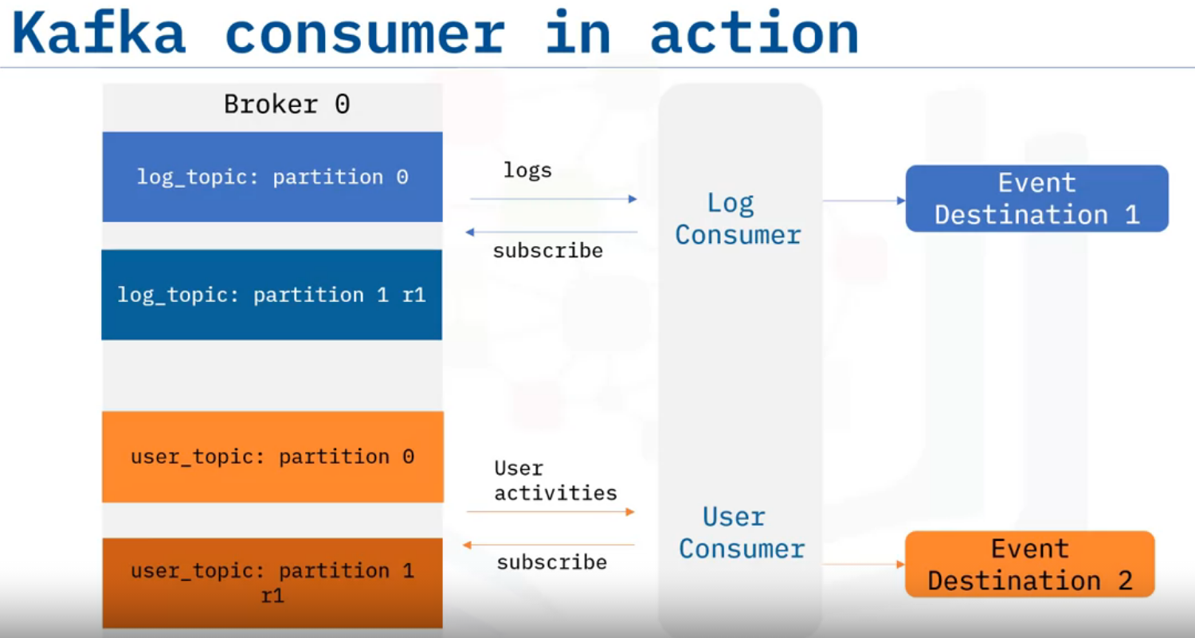
To read published log and user events from topic partitions, you will need to create log and user consumers, and make them subscribe to corresponding topics.
Then Kafka will push the events to those subscribed consumers.
Then, the consumers will further send to event destinations.

Slide 22
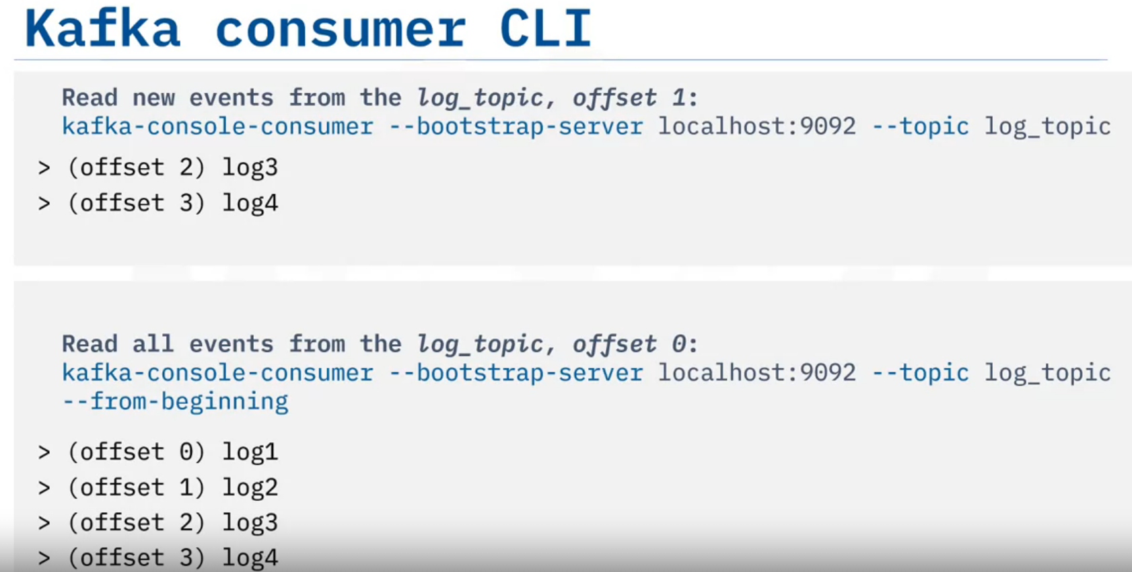
To start a consumer is also easy, using the Kafka consumer script. Let’s read events from the log_topic.
We just need to run the Kafka-console-consumer script and specify a Kafka cluster and the topic to subscribe to.
Here, you can subscribe to and read events from the topic log_topic.
the started consumer will read only the new events, starting from the last partition offset.
After those events are consumed, the partition offset for the consumer will also be updated and committed back to Kafka.
Very often a user wants to read all events from the beginning, as a playback of all historical events.
To do so, you just need to add the ‘from beginning’ option. Now, you can read all events starting from offset 0.

Slide 23
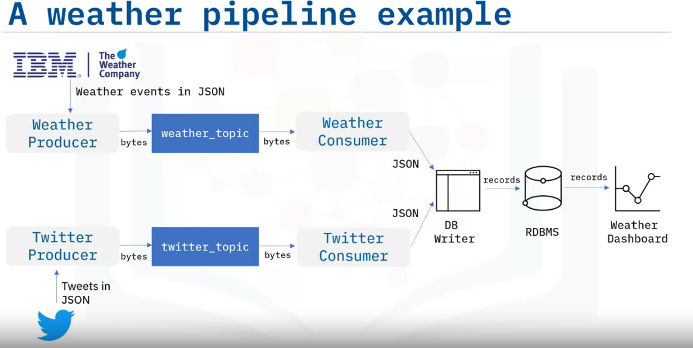

Slide 24
Let’s have a look at a more concrete example to help you understand how to build an event streaming pipeline end-to-end.
Suppose you want to collect and analyze weather and Twitter event streams, so that you can correlate how people talk about extreme weather on Twitter.
Here you can use two event sources: IBM Weather API to obtain real-time and forecasted weather data in JSON format. And Twitter API to obtain real-time tweets and mentions, also in JSON format.
To receive weather and twitter JSON data in Kafka, you then create a weather topic and a Twitter topic in a Kafka cluster, with some partitions and replications.
To publish weather and Twitter JSON data to the two topics, you need to create a weather producer and a Twitter producer.
The event’s JSON data will be serialized into bytes and saved in Kafka topics.
To read events from the two topics, you need to create a weather consumer and a Twitter consumer. The bytes stored in Kafka topics will be deserialized into event JSON data.
If you now want to transport the weather and Twitter event JSON data from the consumers to a relational database, you will use a DB writer to parse those JSON files and create database records.
And then you can write those records into a database using SQL insert statements.
Finally, you can query the database records from the relational database and visualize and analyze them in a dashboard to complete the end-to-end pipeline.

Slide 25
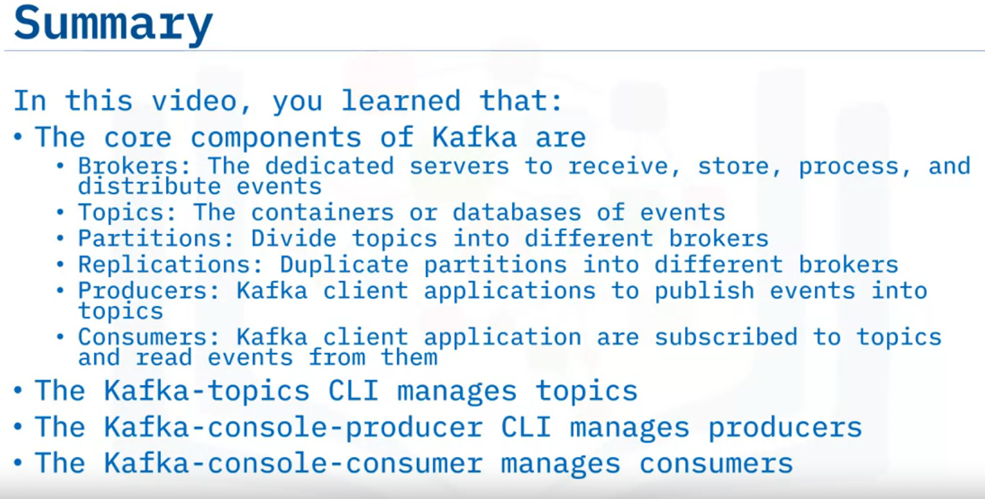

Slide 26
Kafka Streaming Process
Describe what the Kafka Streams API is and its main benefits.
Describe what the Kafka Stream processing topology is.

Slide 27
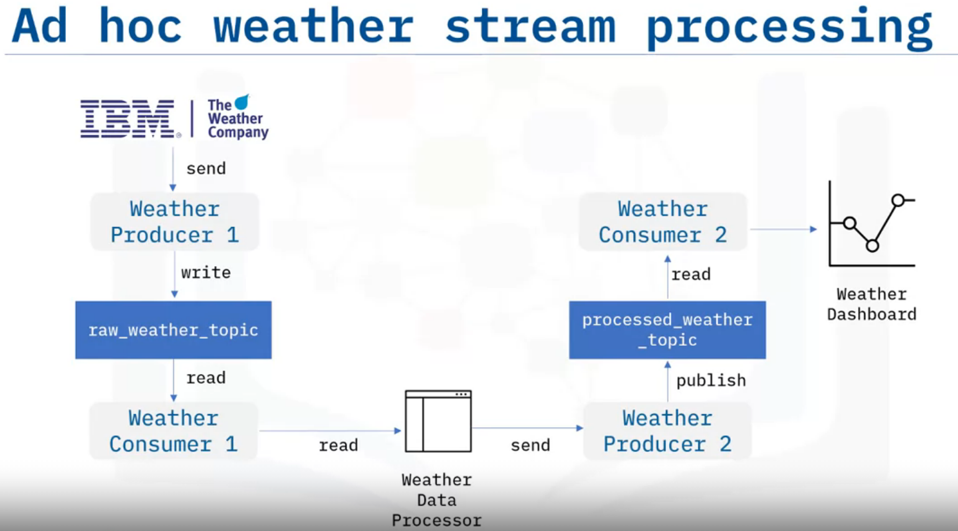
In event streaming, in addition to transporting data, data engineers also need to process data through, for example, data filtering, aggregation, and enhancement.
Any applications developed to process streams are called stream processing applications.
For stream processing applications based on Kafka, a straightforward way is to implement an ad hoc data processor to read events from one topic, process them, and publish them to another topic.
Let’s look at an example. You first request raw weather JSON data from a weather API, and you start a weather producer to publish the raw data into a raw weather topic.
Then you start a consumer to read the raw weather data from the weather topic.
Next, you create an ad hoc data processor to filter the raw weather data to only include extreme weather events, such as very high temperatures.
Such a processor could be a simple script file or an application which works with Kafka clients to read and write data from Kafka.
Afterwards, the processor sends the processed data to another producer, and it gets published to a processed weather topic.
And finally, the processed weather data will be consumed by a dedicated consumer and sent to a dashboard for visualization.
Such ad hoc processors may become complicated if you have many different topics to be processed. A solution that may solve these challenges is Kafka.

Slide 28
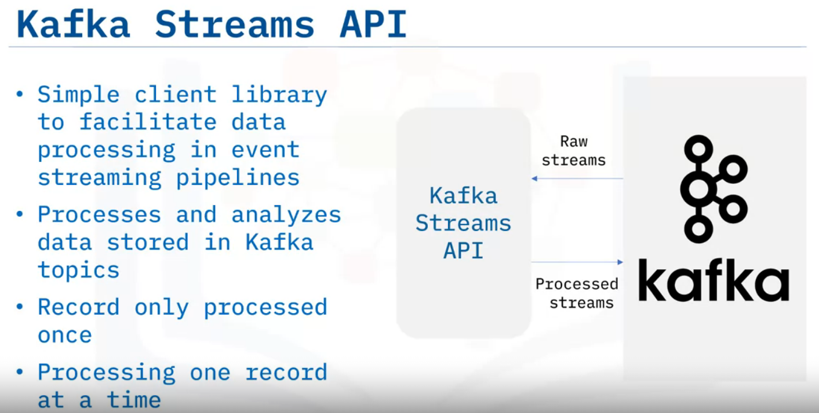
Such ad hoc processors may become complicated if you have many different topics to be processed. A solution that may solve these challenges is Kafka.
It provides the Streams API to facilitate stream processing.
Kafka Streams API is a simple client library aiming to facilitate data processing in event-streaming pipelines.
It processes and analyzes data stored in Kafka topics, thus both the input and output of the Streams API are Kafka topics.
Kafka Streams API ensures that each record will only be processed once.
And finally, it processes only one record at a time.

Slide 29
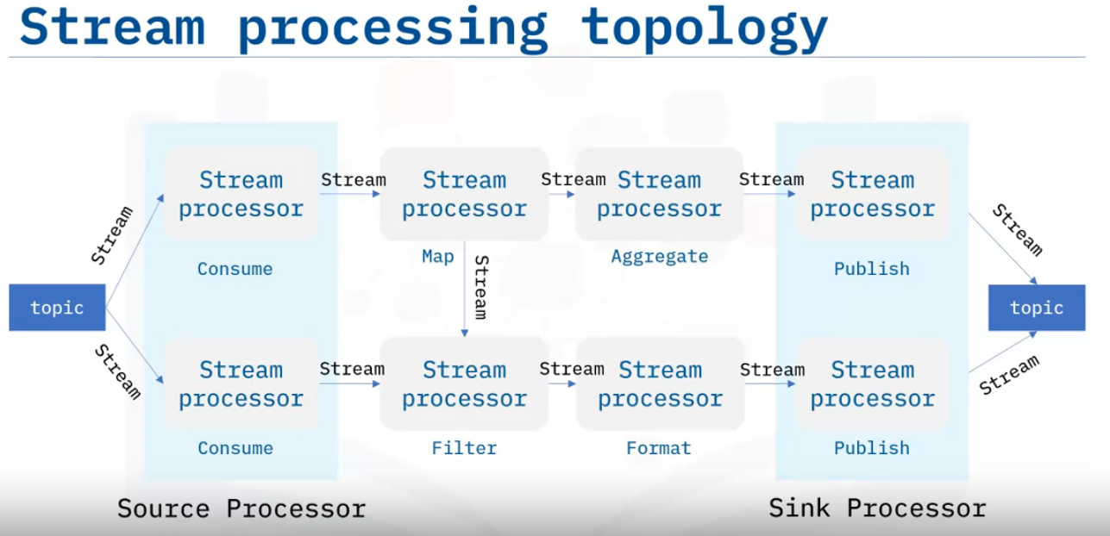
Kafka Streams API is based on a computational graph called a stream-processing topology.
In this topology, each node is a stream processor which receives streams from its upstream processor, performs data transformations such as mapping, filtering, formatting, aggregation, and produces output streams to its downstream stream processors.
Thus, the edges of the graph are I/O streams. There are two special types of processors: On the left, you can see the source processor which has no upstream processors.
A source processor acts like a consumer which consumes streams from Kafka topics and forwards the processed streams to its downstream processors.
On the right, you can see the sink processor, which has no downstream processors.
A sink processor acts like a producer which publishes the received stream to a Kafka topic.

Slide 30
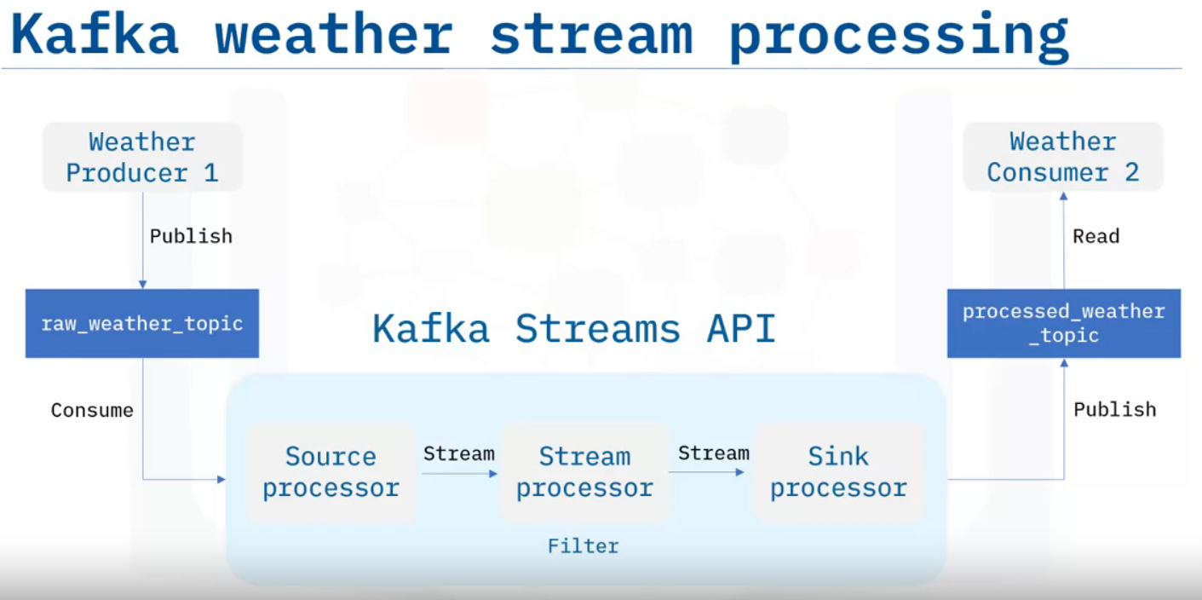
Let’s re-design the previous weather stream processing application with Kafka Streams API.
Suppose you have a raw weather topic and a processed weather topic in Kafka.
Now, instead of spending a huge amount of effort developing an ad hoc processor, you could just plug in the Kafka Streams API here.
In the Kafka Streams topology, we have three stream processors: The source processor that consumes raw weather streams from the raw weather topic and forwards the weather stream to the stream processor to filter the stream based on high temperature.
Then, the filtered stream will be forwarded to the sink processor which then publishes the output to the processed weather topic.
Concluding, this is a much simpler design than an ad hoc data processor, especially if you have many different topics to be processed.

Slide 31
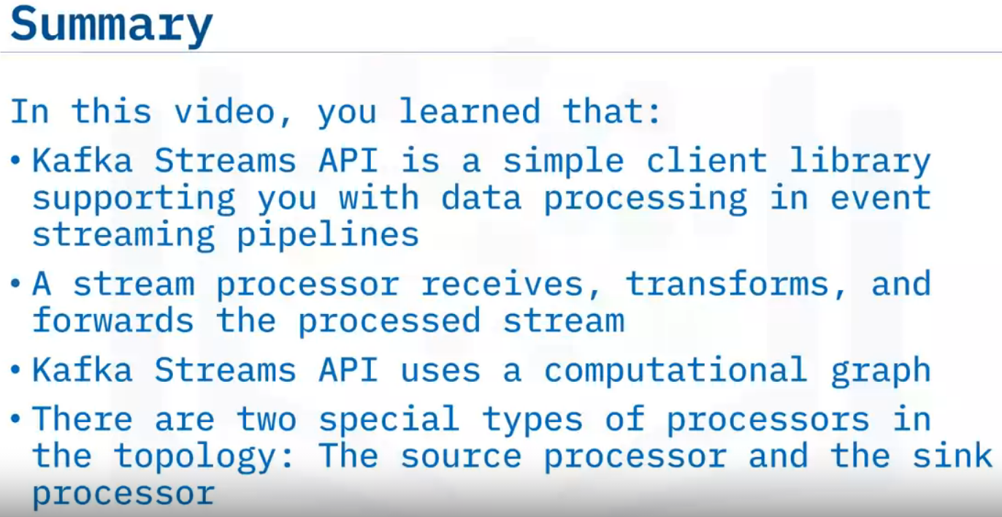

Slide 32
Summary & Highlights
Congratulations! You have completed this module. At this point, you know:
An event stream represents entities’ status updates over time
The main components of an ESP are Event broker, Event storage, Analytic, and Query Engine
Apache Kafka is a very popular open-source ESP
Popular Kafka service providers include Confluent Cloud, IBM Event Stream, and Amazon MSK
The core components of Kafka are brokers, topics, partitions, replications, producers, and consumers
The Kafka-console-consumer manages consumers
Kafka Streams API is a simple client library supporting you with data processing in event streaming pipelines
A stream processor receives, transforms, and forwards the processed stream
Kafka Streams API uses a computational graph
There are two special types of processors in the topology: The source processor and the sink processor

Slide 33
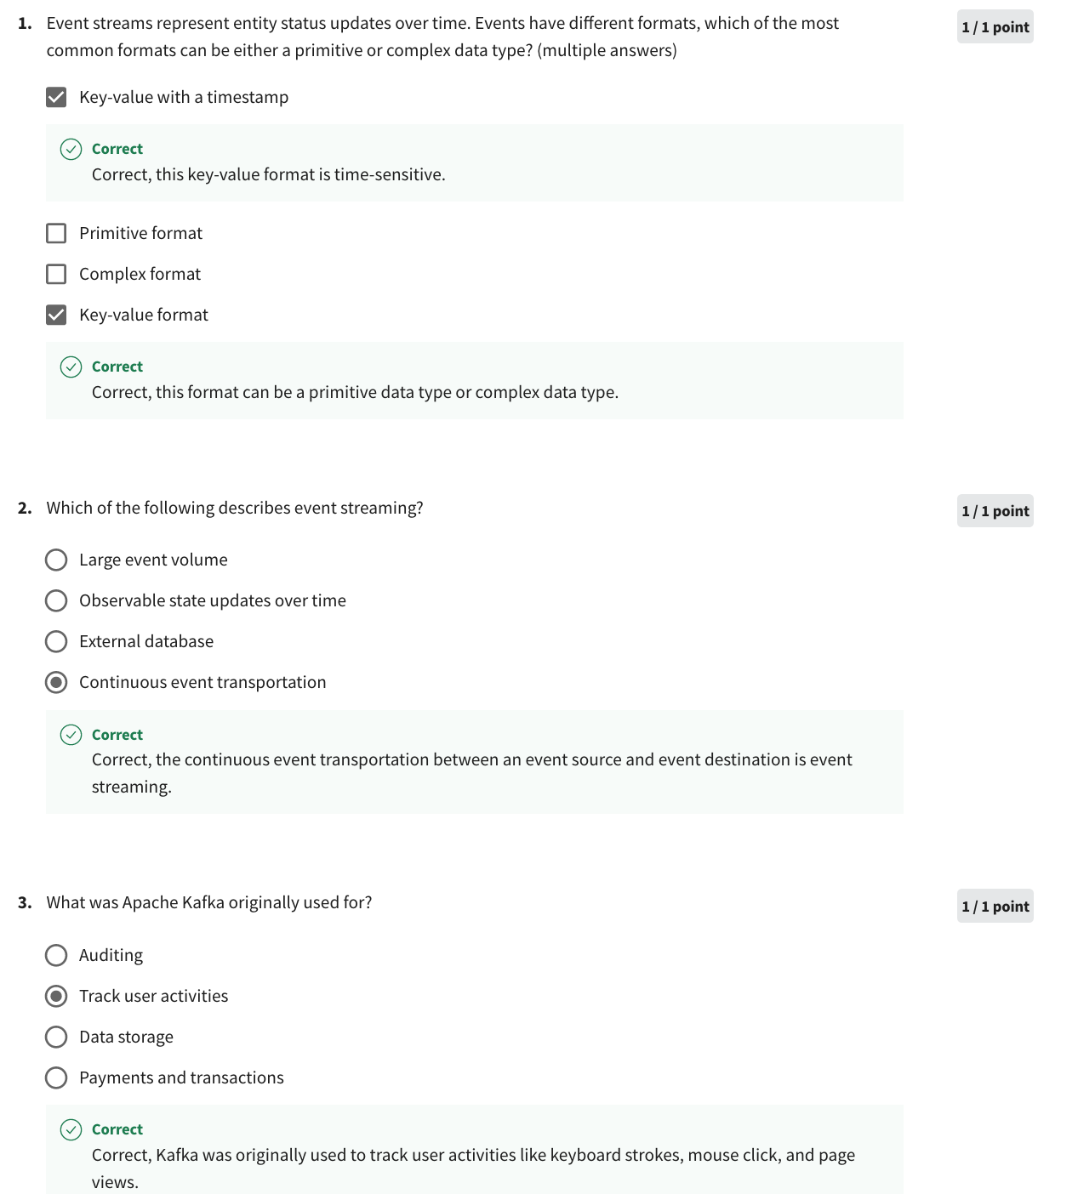
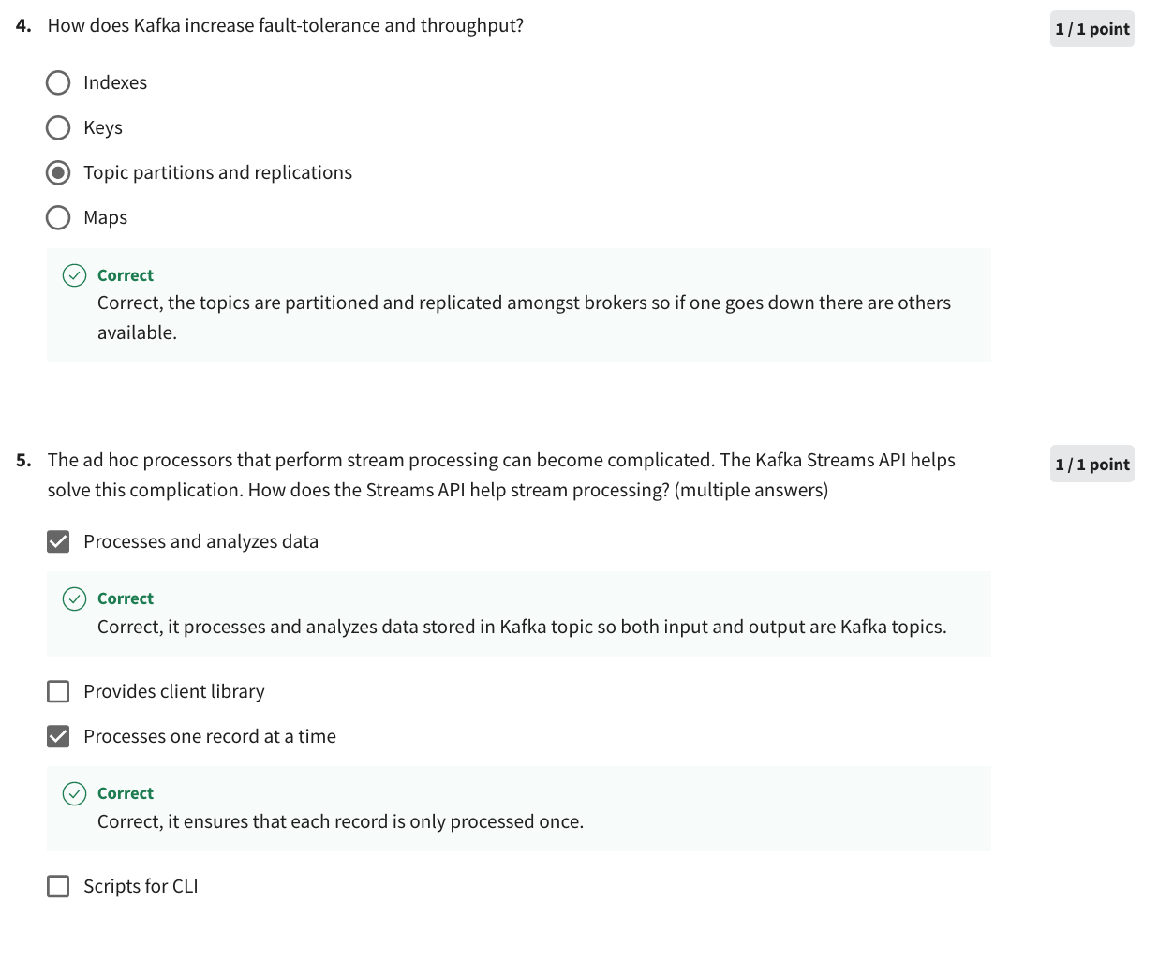

Slide 34
1.Event streams represent entity status updates over time. Events have different formats, which of the most common formats can be either a primitive or complex data type? (multiple answers)
Key-value format
Primitive format
Complex format
Key-value with a timestamp
Of the most common formats for event streams, both the key-value format and the key-value format with a timestamp can be considered as either primitive or complex data types. Let's break it down:
1. Key-value format: This format represents events as a collection of key-value pairs. Each event consists of one or more key-value pairs, where the keys represent different attributes or properties of the entity, and the values provide the corresponding values for those attributes. In this format, both the keys and values can be of primitive data types (e.g., string, integer, boolean, etc.) or complex data types (e.g., nested structures, arrays, etc.).
2. Primitive format: This format represents events using primitive data types only. Each event is a single value that represents the current state or status of the entity. The value can be a primitive data type such as a string, integer, boolean, or any other basic data type.
3. Complex format: This format represents events using complex data types. Each event can have a structure that contains multiple attributes, nested objects, arrays, or other complex data structures to capture detailed information about the entity's status. The structure can be defined using schemas or data models.
4. Key-value with a timestamp: This format extends the key-value format by including a timestamp along with each key-value pair. The timestamp represents the time at which the event occurred or was recorded. It helps in tracking the chronological order of events. Similar to the key-value format, both the keys and values in this format can be either primitive or complex data types.
Therefore, the key-value format, key-value with a timestamp format, and complex format can all be considered as common formats for event streams and can involve both primitive and complex data types. The primitive format, on the other hand, is limited to primitive data types only.

Slide 35
2 Which of the following describes event streaming?
External database
Observable state updates over time
Continuous event transportation
Large event volume
The description that best fits event streaming is "Observable state updates over time."
Event streaming refers to the practice of capturing and processing a continuous stream of events or updates from various sources in real-time. These events represent changes or updates in the state of different entities or systems. Event streaming enables the observation and analysis of these state updates as they occur, allowing applications and systems to react and make decisions based on the most recent information.
While the other options may be associated with event streaming in some contexts, they do not fully capture the essence of event streaming:
- External database: Event streaming can involve capturing events from external databases, but it is not limited to just databases. It encompasses a wider range of data sources and systems.
- Continuous event transportation: Continuous event transportation is a component of event streaming, as it involves the movement of events from producers to consumers in real-time. However, it does not fully encapsulate the concept of event streaming itself.
- Large event volume: Event streaming can indeed involve a large volume of events, especially in scenarios where there are high-frequency updates or when dealing with massive streams of data. However, the volume of events is not the defining characteristic of event streaming.

Slide 36
4.How does Kafka increase fault-tolerance and throughput? choose one
Topic partitions and replications
Keys
Indexes
Maps
Apache Kafka increases fault-tolerance and throughput through "topic partitions and replications."
In Kafka, a topic can be divided into multiple partitions, and each partition is replicated across multiple brokers. This partitioning and replication strategy provides several benefits:
1. Fault-tolerance: By dividing a topic into partitions and replicating them, Kafka ensures that even if some brokers or partitions experience failures, the system can continue to operate without data loss. Replicas can serve as backups and take over in case of failures. This fault-tolerant design helps maintain high availability and reliability.
2. Scalability and throughput: Topic partitions allow Kafka to distribute the load across multiple brokers and enable parallel processing of messages. Each partition can be assigned to a different broker, allowing for concurrent processing. This distributed architecture allows Kafka to handle large volumes of data and provide high throughput.
3. Parallelism and consumer scalability: With topic partitions, Kafka allows multiple consumers to read from different partitions concurrently. This parallel consumption capability enables high scalability for consumer applications, as each consumer can process a subset of partitions independently, increasing overall throughput.
In summary, the use of topic partitions and replications in Apache Kafka enhances fault-tolerance by providing redundancy and resilience to failures, while also increasing throughput by enabling parallel processing and distributed consumption of messages.

Slide 37
5. The ad hoc processors that perform stream processing can become complicated. The Kafka Streams API helps solve this complication. How does the Streams API help stream processing? (multiple answers)
Processes one record at a time
Provides client library
Scripts for CLI
Processes and analyzes data
The Kafka Streams API helps with stream processing by providing the following benefits:
1. Processes one record at a time: The Streams API allows processing of individual records from Kafka topics in a streaming fashion. It provides the ability to handle each record independently, enabling real-time processing and analysis of data as it arrives.
2. Provides client library: The Streams API is a client library provided by Apache Kafka. It simplifies the development of stream processing applications by providing a high-level abstraction layer and a set of easy-to-use APIs. This helps developers focus on business logic rather than dealing with low-level details of stream processing.
3. Processes and analyzes data: The Streams API facilitates the processing and analysis of data streams. It supports various operations such as filtering, mapping, aggregating, joining, and windowing. These operations can be used to transform and analyze the incoming data in real-time, enabling tasks like data enrichment, pattern detection, or complex analytics.
The option "Scripts for CLI" is not directly related to the Kafka Streams API. While Kafka does provide a command-line interface (CLI) for administrative tasks, such as topic management and cluster configuration, it is not specifically tied to the Streams API.
In summary, the Kafka Streams API helps streamline the development and execution of stream processing applications by allowing processing of individual records, providing a client library for simplified development, and enabling data processing and analysis in real-time.

